Slide 1


DOT Stop Procedure
How to produce your driver log from the Samsara app if stopped by a DOT officer and they ask for it

Slide 2
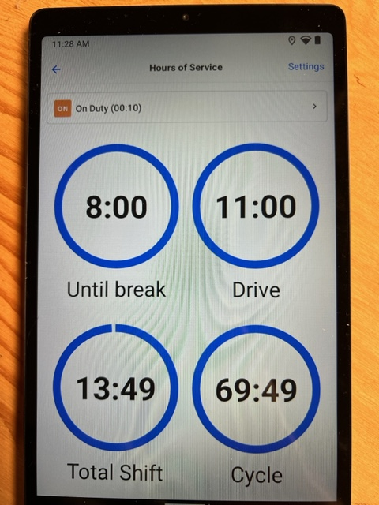
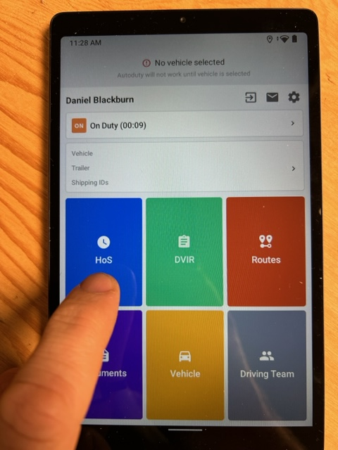
This page will appear, scroll down below the circles
From your home screen, press the HoS (Hours of Service) button

Slide 3
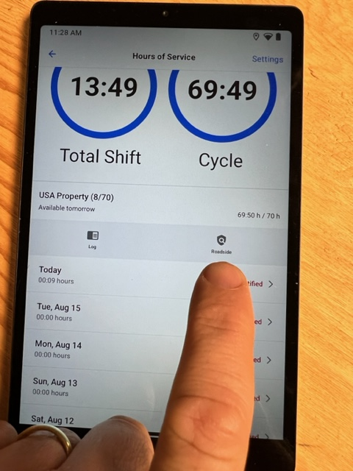
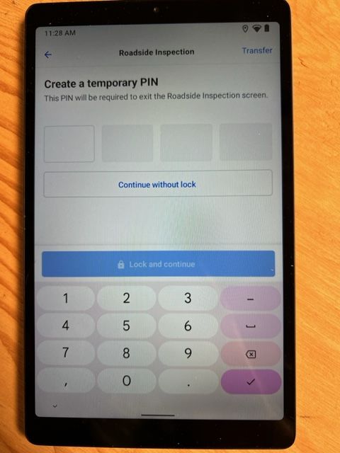
You will see an icon that says “Roadside”, click on that icon
This page will appear. You will need to create a PIN number, it can be anything that you want. You need to be sure to choose something that you will remember, it does not matter what four numbers you choose

Slide 4
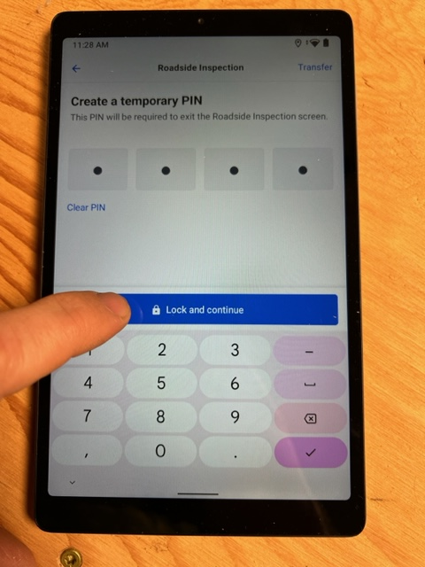
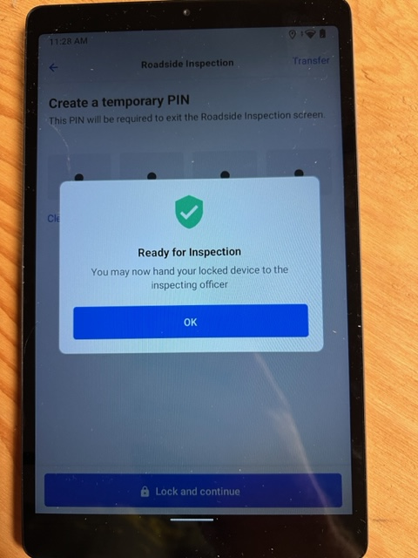
Click the “Lock and Continue” bar
This will pop up, click “OK”

Slide 5
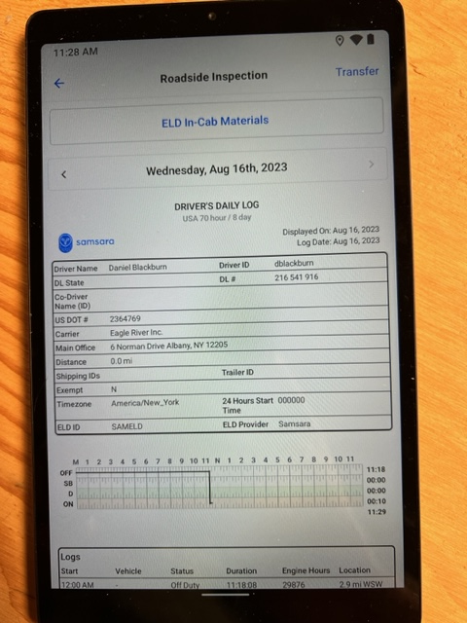
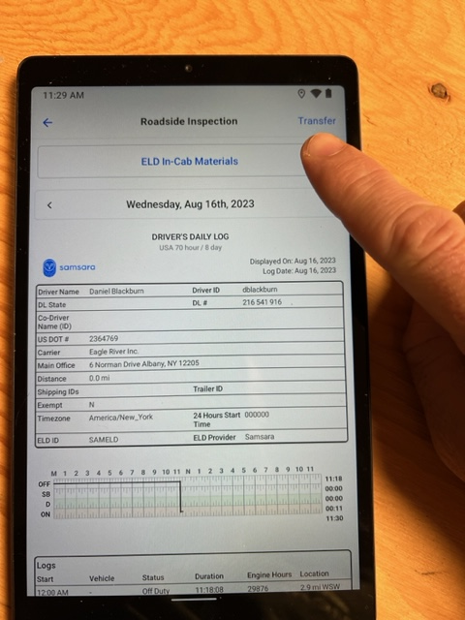
Your daily log will pop up. At this point the DOT officer may ask to see just this part, hand them the tablet and they will advise from there.
If they ask to have the log transferred, click the word “Transfer” in the top right corner

Slide 6
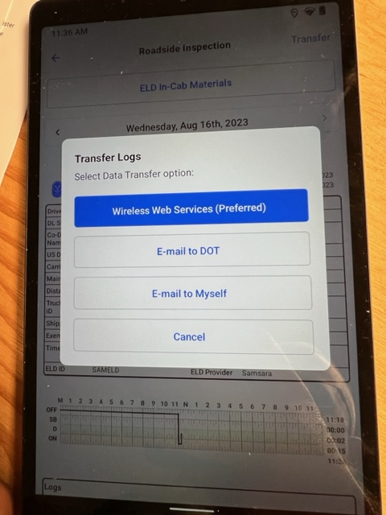
This will pop up, the DOT officer will need to advise you where they would like it transfered

Slide 7
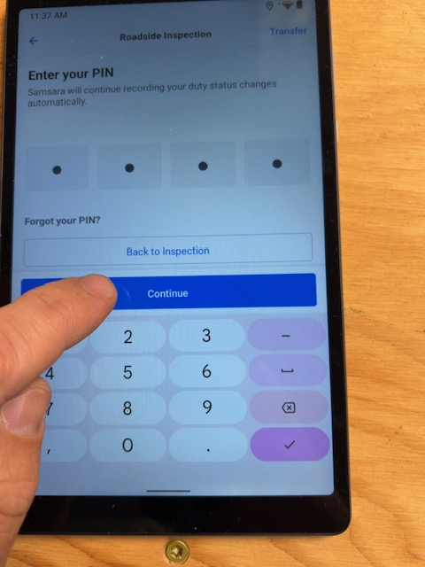
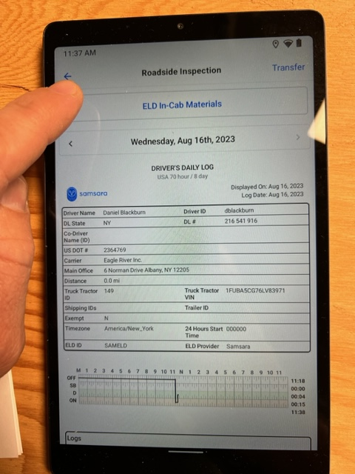
From there, to get back to your home screen, press the blue arrow in the top left corner of the screen
Type in the PIN number from earlier and click “Continue”

Slide 8
If you have any questions, please do not hesitate to ask. We need ensure that all drivers are able to understand this protocol and the processes that go with is.
DOT requires that all ELD devices, whether it be your phone or the tablets that we have provided, are mounted on the dashboard of the vehicle. If you are driving a vehicle and the mount is broken or defective, be sure to mention it to either Garret or Mark so that we can get it fixed.

